Slide 1
Work on Multiple Table
Join and Set Operation

Slide 2
JOINING

Slide 3

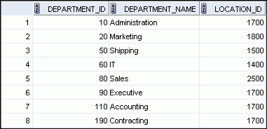

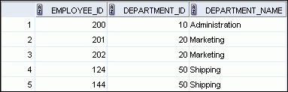

Obtaining Data from Multiple Tables
EMPLOYEES
DEPARTMENTS
…
…
Notes:
Obtaining Data from Multiple Tables
Sometimes you need to use data from more than one table. In the example in the slide, the report displays data from two separate tables:
Employee IDs exist in the EMPLOYEES table.
Department IDs exist in both the EMPLOYEES and DEPARTMENTS tables.
Department names exist in the DEPARTMENTS table.
To produce the report, you need to link the EMPLOYEES and DEPARTMENTS tables, and access data from both of them.

Slide 4
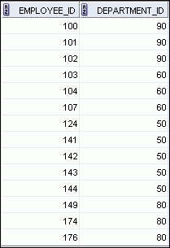
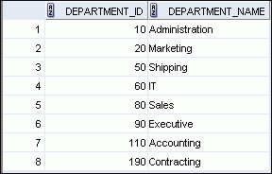
Joining Column Names
EMPLOYEES
DEPARTMENTS
Primary key
…
Foreign key
Notes:
Joining Column Names
To determine an employee’s department name, you compare the value in the DEPARTMENT_ID column in the EMPLOYEES table with the DEPARTMENT_ID values in the DEPARTMENTS table. The relationship between the EMPLOYEES and DEPARTMENTS tables is an equijoin; that is, values in the DEPARTMENT_ID column in both the tables must be equal. Frequently, this type of join involves primary and foreign key complements.
Note: Equijoins are also called simple joins or inner joins.

Slide 5
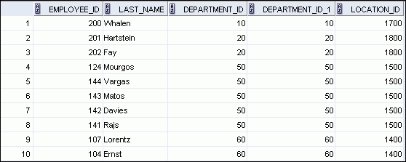
Retrieving Records with the ON Clause
SELECT e.employee_id, e.last_name, e.department_id,
d.department_id, d.location_id
FROM employees e JOIN departments d
ON (e.department_id = d.department_id);
…
Notes:
Retrieving Records with the ON Clause
In this example, the DEPARTMENT_ID columns in the EMPLOYEES and DEPARTMENTS table are joined using the ON clause. Wherever a department ID in the EMPLOYEES table equals a department ID in the DEPARTMENTS table, the row is returned. The table alias is necessary to qualify the matching column_names.
You can also use the ON clause to join columns that have different names. The parenthesis around the joined columns as in the slide example, (e.department_id = d.department_id) is optional. So, even ON e.department_id = d.department_id will work.
Note: SQL Developer suffixes a ‘_1’ to differentiate between the two department_ids.

Slide 6
INNER Versus OUTER Joins
In SQL:1999, the join of two tables returning only matched rows is called an inner join.
A join between two tables that returns the results of the inner join as well as the unmatched rows from the left (or right) table is called a left (or right) outer join.
A join between two tables that returns the results of an inner join as well as the results of a left and right join is a full outer join.
Notes:
INNER Versus OUTER Joins
Joining tables with the NATURAL JOIN, USING, or ON clauses results in an inner join. Any unmatched rows are not displayed in the output. To return the unmatched rows, you can use an outer join. An outer join returns all rows that satisfy the join condition and also returns some or all of those rows from one table for which no rows from the other table satisfy the join condition.
There are three types of outer joins:
LEFT OUTER
RIGHT OUTER
FULL OUTER

Slide 7
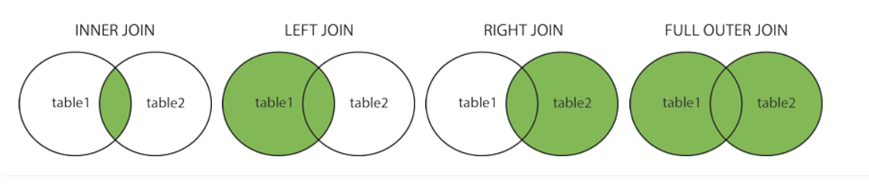
JOIN
mengambil data dari lebih dari satu table
Contoh: SELECT * FROM table1 INNER JOIN table2 ON table2.CustomerID=table1.CustomerID;

Slide 8
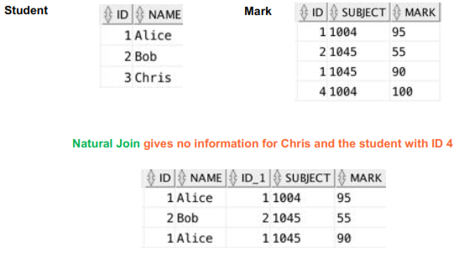
INNER JOIN
SELECT * FROM student s INNER JOIN mark m ON s.ID = m.ID

Slide 9
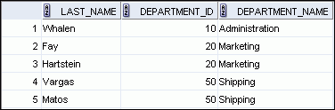

LEFT OUTER JOIN
SELECT e.last_name, e.department_id, d.department_name
FROM employees e LEFT OUTER JOIN departments d
ON (e.department_id = d.department_id) ;
…
Notes:
LEFT OUTER JOIN
This query retrieves all rows in the EMPLOYEES table, which is the left table, even if there is no match in the DEPARTMENTS table.

Slide 10
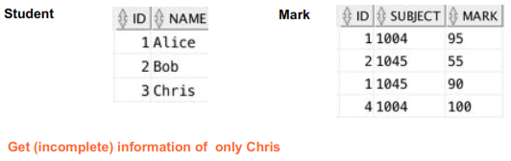
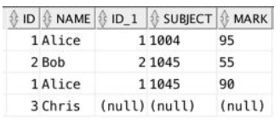
LEFT OUTER JOIN
SELECT *
FROM student s
LEFT OUTER JOIN mark m
ON s.ID = m.ID

Slide 11
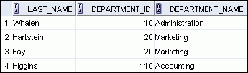

RIGHT OUTER JOIN
SELECT e.last_name, e.department_id, d.department_name
FROM employees e RIGHT OUTER JOIN departments d
ON (e.department_id = d.department_id) ;
…
Notes:
RIGHT OUTER JOIN
This query retrieves all rows in the DEPARTMENTS table, which is the right table, even if there is no match in the EMPLOYEES table.

Slide 12
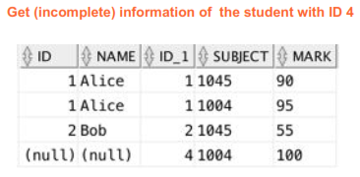
RIGHT OUTER JOIN
SELECT *
FROM student s
RIGHT OUTER JOIN mark m
ON s.ID = m.ID

Slide 13
FULL OUTER JOIN
SELECT e.last_name, d.department_id, d.department_name
FROM employees e FULL OUTER JOIN departments d
ON (e.department_id = d.department_id) ;
…
Notes:
FULL OUTER JOIN
This query retrieves all rows in the EMPLOYEES table, even if there is no match in the DEPARTMENTS table. It also retrieves all rows in the DEPARTMENTS table, even if there is no match in the EMPLOYEES table.

Slide 14
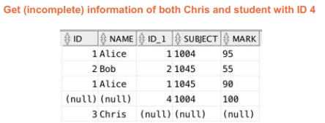
FULL OUTER JOIN
SELECT *
FROM student s
FULL OUTER JOIN mark m
ON s.ID = m.ID

Slide 15
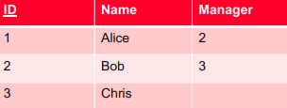
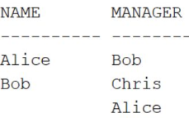
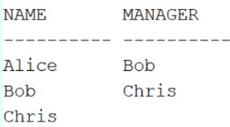
Apa hasil Query ini?
SELECT e1.NAME as name,
e2.name as manager
FROM employee e1
RIGHT OUTER JOIN employee e2
ON e1.manager = e2.id;
A
B

Slide 16


Buat Query?
Employee
Project
“ untuk tiap employee, berapa total jumlah biaya project atas semua project yang ditugaskan kepada mereka?”
A . SELECT e.name, sum(cost) as total FROM employee e LEFT OUTER JOIN project p on e.id = p.empid GROUP BY e.name;
B. SELECT e.name, sum(cost) as total FROM employee e RIGHT OUTER join project p on e.id = p.empid GROUP BY e.name;
C. SELECT e.name, ISNULL(sum(cost),0) as total FROM employee e LEFT OUTER JOIN project p on e.id = p.empid GROUP BY e.name;
D. Tidak ada yang benar

Slide 17
Buat Query
“Ada berapa employee yang menerima salary tidak sesuai dengan ketentuan salary atas job_id nya?”

Slide 18
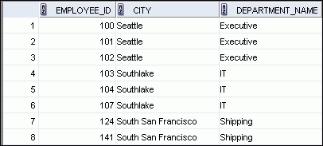
Creating Three-Way Joins with the ON Clause
SELECT employee_id, city, department_name
FROM employees e
JOIN departments d
ON d.department_id = e.department_id
JOIN locations l
ON d.location_id = l.location_id;
…
Notes:
Creating Three-Way Joins with the ON Clause
A three-way join is a join of three tables. In SQL:1999–compliant syntax, joins are performed from left to right. So, the first join to be performed is EMPLOYEES JOIN DEPARTMENTS. The first join condition can reference columns in EMPLOYEES and DEPARTMENTS but cannot reference columns in LOCATIONS. The second join condition can reference columns from all three tables.
Note: The code example in the slide can also be accomplished with the USING clause:
SELECT e.employee_id, l.city, d.department_name
FROM employees e
JOIN departments d
USING (department_id)
JOIN locations l
USING (location_id)

Slide 19
SET OPERATION

Slide 20
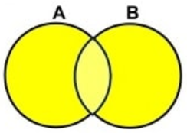
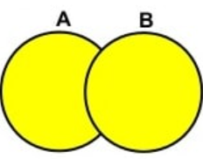
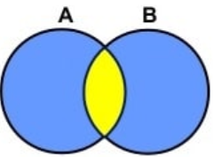
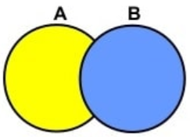
Relational Set Operations
UNION COMPATIBLE
Same number of attributes
Similar datatypes
UNION ALL
UNION
INTERSECT
EXCEPT
Semua row digabungkan. Walau ada row duplikat
Semua row digabungkan dan row yang duplikat di hilangkan (disisakan satu). Distinct dari UNION ALL
Ditampilkan row duplikat (ada di kedua sisi), namun hanya distinct row yang disisakan
Ditampilkan semua row dari sisi kiri, namus row-row yang juga ada pada sisi kanan dihilangkan

Slide 21

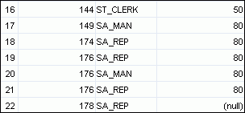
Using the UNION ALL Operator
Display the current and previous departments of all employees.
SELECT employee_id, job_id, department_id
FROM employees
UNION ALL
SELECT employee_id, job_id, department_id
FROM job_history
ORDER BY employee_id;
…
…
Notes:
Using the UNION ALL Operator
In the example, 30 rows are selected. The combination of the two tables totals to 30 rows. The UNION ALL operator does not eliminate duplicate rows. UNION returns all distinct rows selected by either query. UNION ALL returns all rows selected by either query, including all duplicates. Consider the query in the slide, now written with the UNION clause:
SELECT employee_id, job_id,department_id FROM employees UNION SELECT employee_id, job_id,department_id FROM job_history ORDER BY employee_id;
The preceding query returns 29 rows. This is because it eliminates the following row (because it is a duplicate):

Slide 22


Using the UNION Operator
Display the current and previous job details of all employees. Display each employee only once.
SELECT employee_id, job_id
FROM employees
UNION
SELECT employee_id, job_id
FROM job_history;
…
…
Notes:
Using the UNION Operator
The UNION operator eliminates any duplicate records. If records that occur in both the EMPLOYEES and the JOB_HISTORY tables are identical, the records are displayed only once. Observe in the output shown in the slide that the record for the employee with the EMPLOYEE_ID 200 appears twice because the JOB_ID is different in each row.
Consider the following example:
SELECT employee_id, job_id, department_id
FROM employees
UNION
SELECT employee_id, job_id, department_id
FROM job_history;
…
…

Slide 23

Using the INTERSECT Operator
Display employees who have a same job from the job history table
SELECT employee_id, job_id
FROM employees
INTERSECT
SELECT employee_id, job_id
FROM job_history;
Notes:
Using the UNION Operator
The UNION operator eliminates any duplicate records. If records that occur in both the EMPLOYEES and the JOB_HISTORY tables are identical, the records are displayed only once. Observe in the output shown in the slide that the record for the employee with the EMPLOYEE_ID 200 appears twice because the JOB_ID is different in each row.
Consider the following example:
SELECT employee_id, job_id, department_id
FROM employees
UNION
SELECT employee_id, job_id, department_id
FROM job_history;
…
…

Slide 24
Using the EXCEPT Operator
SELECT employee_id, job_id
FROM employees
EXCEPT
SELECT employee_id, job_id
FROM job_history;
Dua row yang sebelumnya menjadi hasil INTERCEPT hilang dari tampilan result

Slide 25
Buat Query
Berapakah jumlah employee yang bekerja di US namun salary yang diterima lebih rendah dari pada jumlah rata-rata salary employee yang berkedudukan di luar US
Hint: data Salary di Table Employees, data negara di table location

